Slide 1
Group 7 -Weather Analysis Using Machine Learning
Abdul Aziz Mohammed - 2215231
Ashwitha Reddy Nimmala – 2313782
FNU Syed Sohaib Ali - 2209809
Neeraj Vasanthapu - 2216992

Slide 2
Introduction
Weather forecasting impacts various sectors like agriculture and transportation. The project focuses on using machine learning to predict weather patterns, specifically temperatures and humidity changes. Traditional methods sometimes struggle with today's unpredictable weather, so the project explores using more advanced models like LSTM, SVR, Random Forest, and XGBoost. The main goal is to make weather predictions more accurate to help plan better for farming, city management, and dealing with disasters.

Slide 3
Dataset Descripiton
The dataset consists of 96453 instances and 12 features.
Time range: April 2006 – 2016
Key weather metrics: Temperature, Apparent Temperature, Humidity, Wind Speed, Pressure, Summary, PrecipType
The categorical features include Summary, PrecipType,Daily summary
The numeric features include Temperature (c),Apparent Temperature(c) ,Humidity, Wind Speed,Wind Bearing,Visibility,Pressure
The date time feature is Formatted Date

Slide 4
Model Descripiton
LSTM (Long Short-Term Memory): A recurrent neural network which is great at understanding patterns over time, and it is perfect for predicting sequences like weather changes.
VAR (Vector Autoregression): This is the statistical model tracks how different weather factors relate over time, helping to predict future values based on their past connections.
SVR (Support Vector Regression): It is an adaptation of Support Vector Machines (SVM) for regression problems. It is capable of handling both linear and non-linear relationships.
XGBoost (Extreme Gradient Boosting): This model is like a rapid learner, continuously improving by focusing on its past errors. It's especially effective at handling various types of weather data, refining predictions by learning from previous iteration

Slide 5
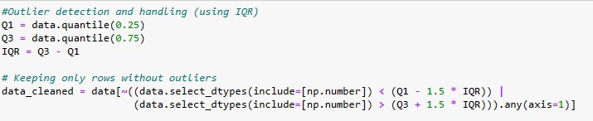
Exploratory Data Analysis
In our exploratory data analysis (EDA), we made sure to deal with outliers, which are data points significantly different from others. To spot these, we used box plots showing the middle values, spread, and any extreme data points. We used a method called Interquartile Range (IQR), which helped us filter out the data that fell far away from the typical range, making our dataset more accurate.

Slide 6
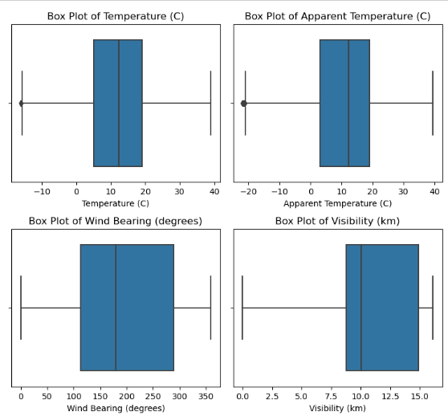
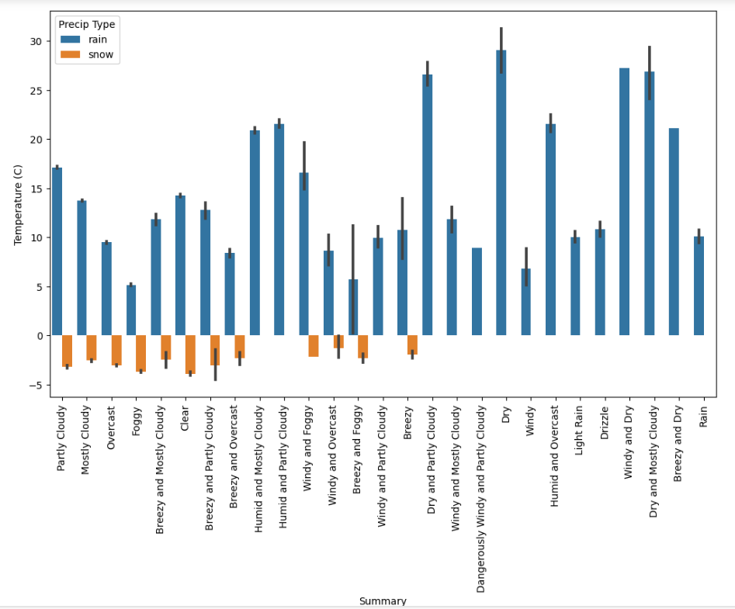
Exploratory Data Analysis
Creating box plots after removing outliers
Relationship between Temperature(c)’ and PrecipType’

Slide 7
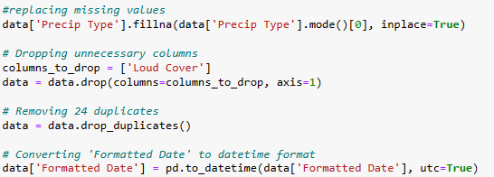
Data Preprocessing
Handling Missing Values: Replaced missing data with the most common values to ensure completeness.
Dropping Unwanted Columns: Removed irrelevant columns to streamline the dataset.
Removing Duplicates: Eliminated identical data entries for accuracy.
Data Formatting: Adjusted the date column format for better time-based analysis.

Slide 8
Model Building
LSTM: Here the data adjusted for LSTM's sequence format by reorganizing variables and creating time-lagged features. Temperature values were scaled consistently. 80% of the dataset trained the LSTM on past weather. The LSTM model was iteratively trained using Keras, adjusting batch sizes during training rounds.
VAR:This model uses multiple time-based variables like temperature and humidity. We checked and adjusted non-stationary series to ensure stationarity. With a lag order of 5 determined by criteria like AIC, we fitted the VAR model and made predictions.
SVR: Data was prepared for lagged features similar to LSTM and scaled for SVR's sensitivity. SVR model was trained on these scaled features and used for predictions on the test set, aiming to find the best-fit line within a defined threshold.
Extreme Gradient Boosting: Features were arranged similarly to the SVR model, with lagged variables and scaling. The model was trained using gradient boosting on the training set to refine predictions iteratively.

Slide 9
Model Performance
Model | MSE | MAE | R2 value
LSTM | 2 | 0.97 | 0.97
Vector Auto Regressor | 1.51 | 0.70 | 0.82
Support Vector Regressor | 1.94 | 0.88 | 0.98
Gradient Boosting | 2.01 | 0.88 | 0.97

Slide 10
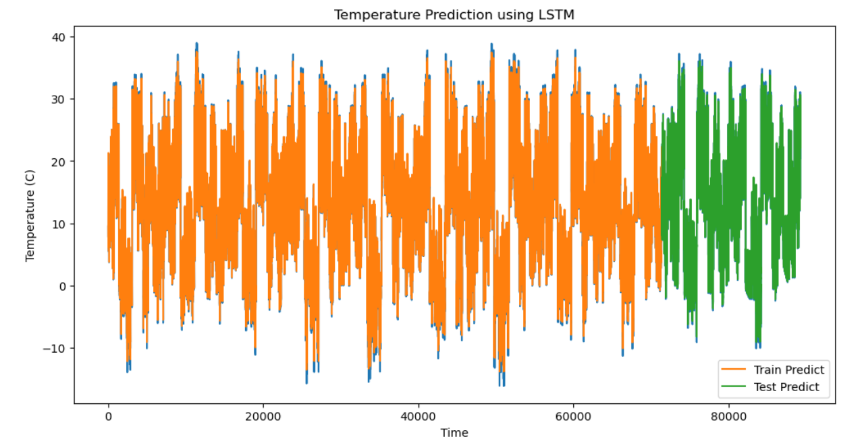
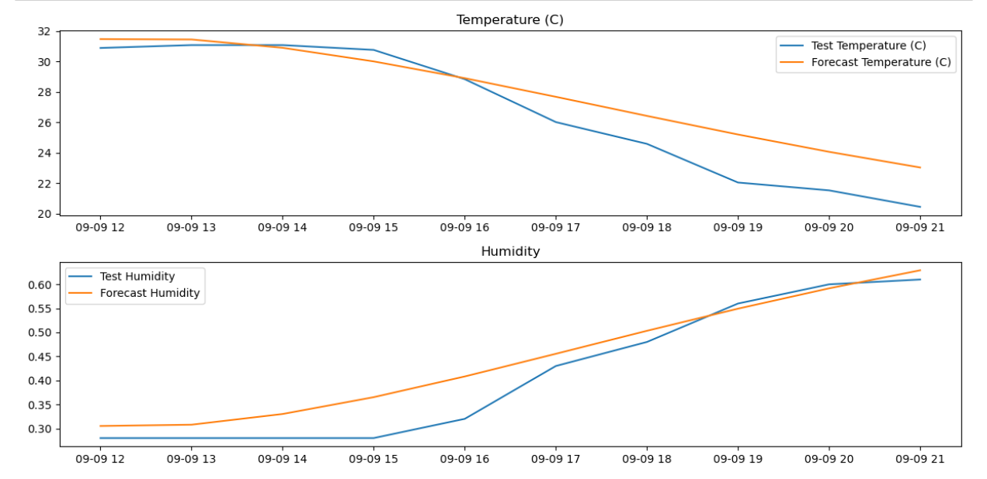
Results
LSTM ( Recurrent Neural Network)
Vector Auto Regressor
The graph shows LSTM temperature predictions closely matching the overall temperature trend in training and testing
The relationship between temperature and humidity often exhibits an inverse pattern, as observed in this scenario. The closeness of forecast and test lines confirms the model is on the right track with its predictions.

Slide 11
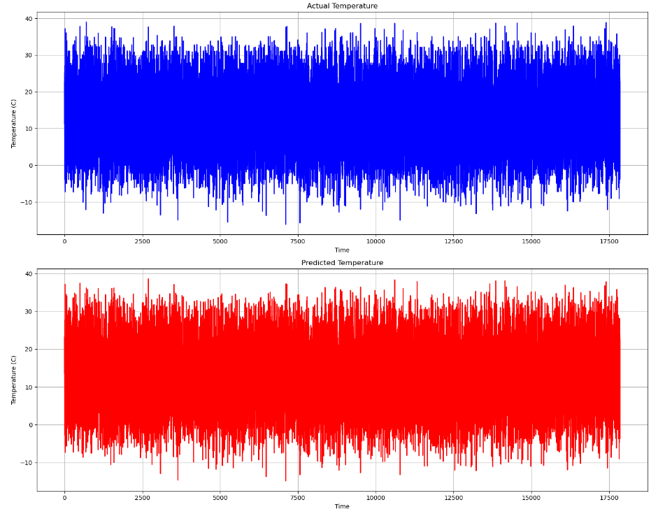
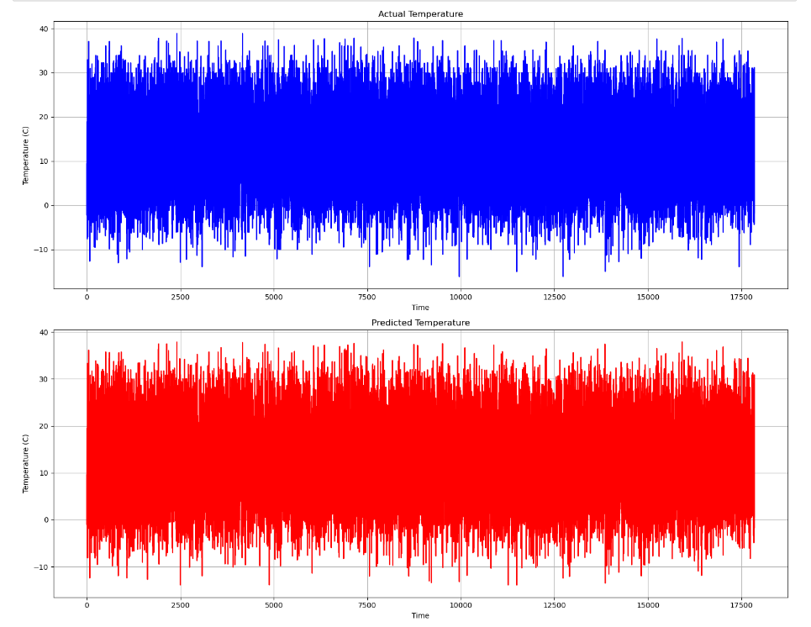
Results
Support Vector Regressor
Extreme Gradient Boosting
The graph shows both actual and predicted temperatures. Their close similarity suggests the model captures temperature variations well without significant errors or outliers.
In the below graph,both actual and predicted temperatures closely match in the higher range, displaying frequent fluctuations.

Slide 12
Conclusion
In conclusion, after analyzing temperature data, it was clear that the model could accurately replicate overall temperature patterns and changes seen in real data over an extended period. The temperature data analysis shows that the prediction model accurately captures temperature trends, demonstrating a strong alignment between predicted and actual temperature fluctuations.
Among all the four models support vector regressor performs the best for the dataset with a r2 score of 0.98, thereby providing an indication of the goodness of fit of the model

